Slide 1
Applications of Information & Communication Technology
Mr. Ali Haider
Institute Of Management Sciences

Slide 2
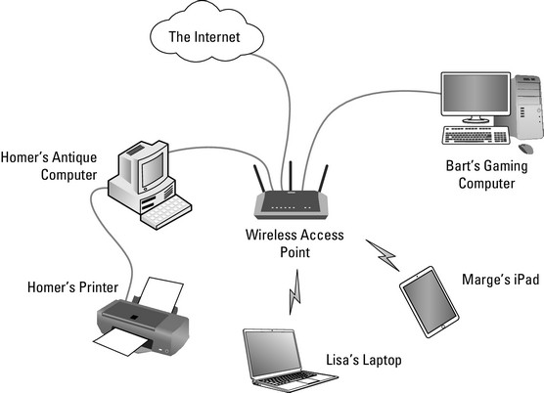
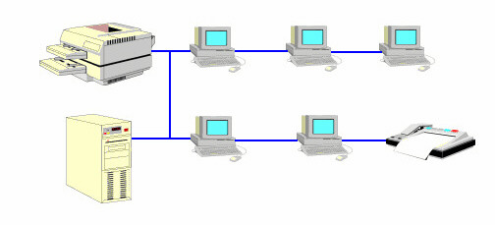
Network
A network consists of two or more devices that are linked in order to share resources (such as printers and CDs), exchange files, or allow electronic communications.

Slide 3
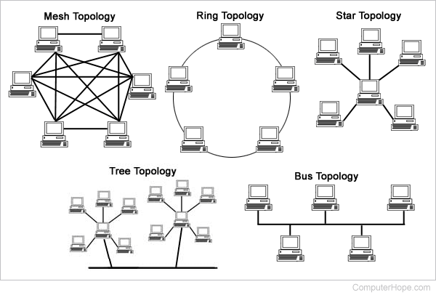
TOPOLOGIES

Slide 4
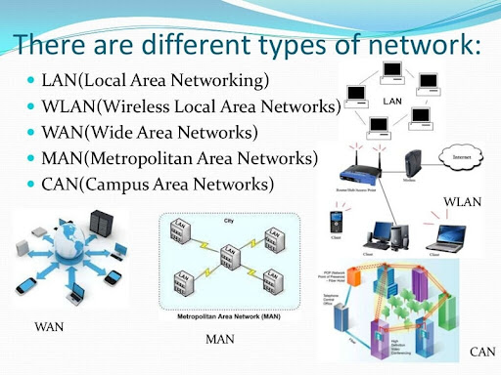

Slide 5
Network Devices:
Networking hardware
Physical devices that allow hardware on a computer network to communicate and interact with one another.
Hardware (Computers, Printers, Scanners, Projectors etc.)
These hardware are also known as Nodes, End Points.
Internetwork VS Intranetwork

Slide 6
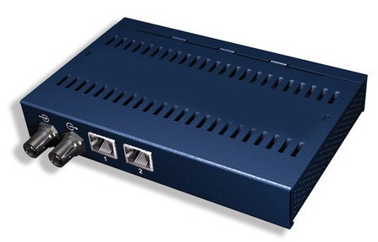
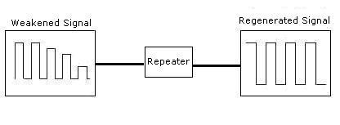
Repeater
Operates at the physical layer.
Amplifies/regenerates the signal over the same network before the signal becomes too weak or corrupted to extend the length to which the signal can be transmitted over the same network.
It is a 2-port device.

Slide 7
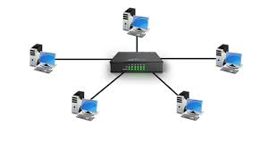
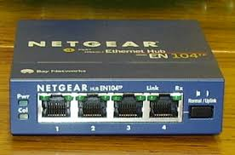
Hub
Basically multi-port repeater.
A hub connects multiple wires coming from different branches, for example, the connector in star topology which connects different stations.
Hubs cannot filter data, so data packets are sent to all connected devices.
They do not have the intelligence to find out the best path for data packets which leads to inefficiencies and wastage.

Slide 8
Types of Hub
Active Hub:- These are the hubs that have their power supply and can clean, boost, and relay the signal along with the network. It serves both as a repeater as well as a wiring center. These are used to extend the maximum distance between nodes.
Passive Hub:- These are the hubs that collect wiring from nodes and power supply from the active hub. These hubs relay signals onto the network without cleaning and boosting them and can’t be used to extend the distance between nodes.
Intelligent Hub:- It works like an active hub and includes remote management capabilities. They also provide flexible data rates to network devices. It also enables an administrator to monitor the traffic passing through the hub and to configure each port in the hub.

Slide 9
NIC
Network interface card is a network adapter that is used to connect the computer to the network.
It has a unique id that is written on the chip, and it has a connector to connect the cable to it. The cable acts as an interface between the computer and the router or modem.

Slide 10
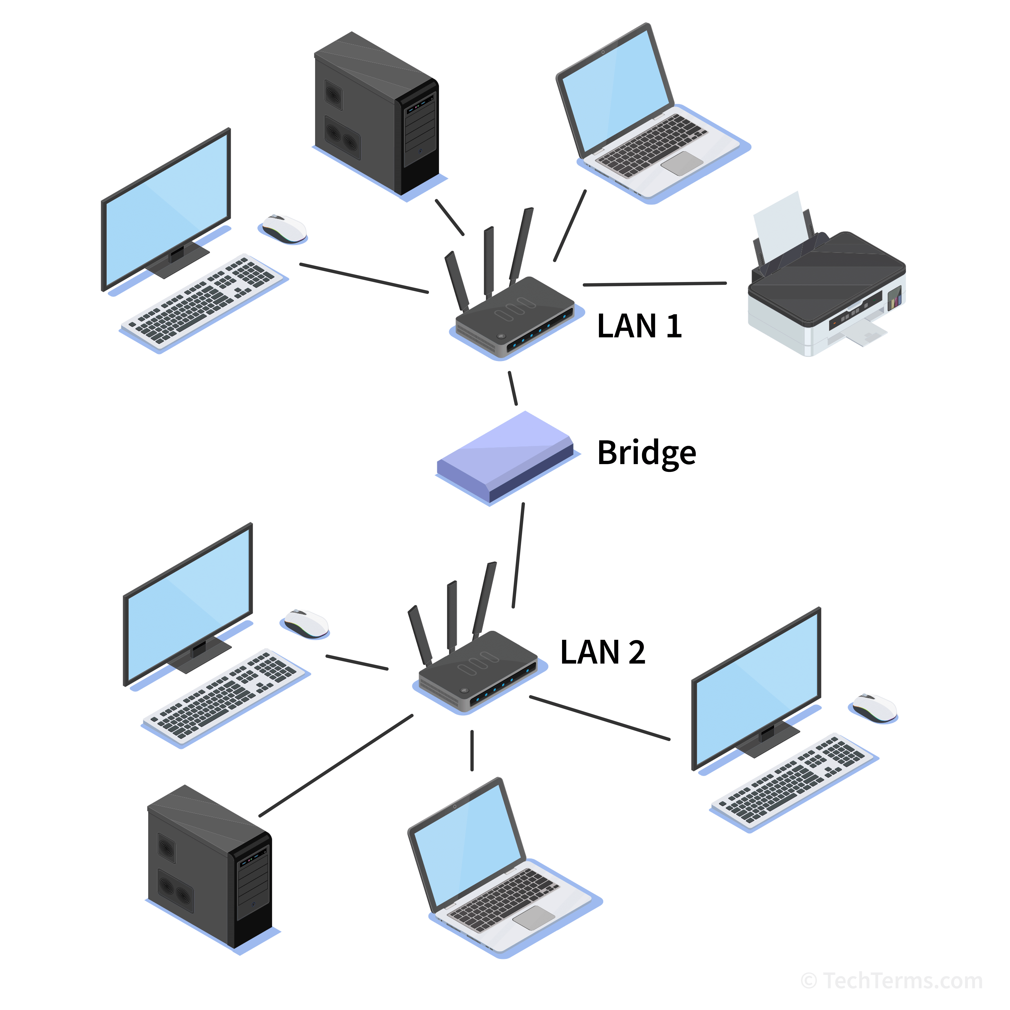
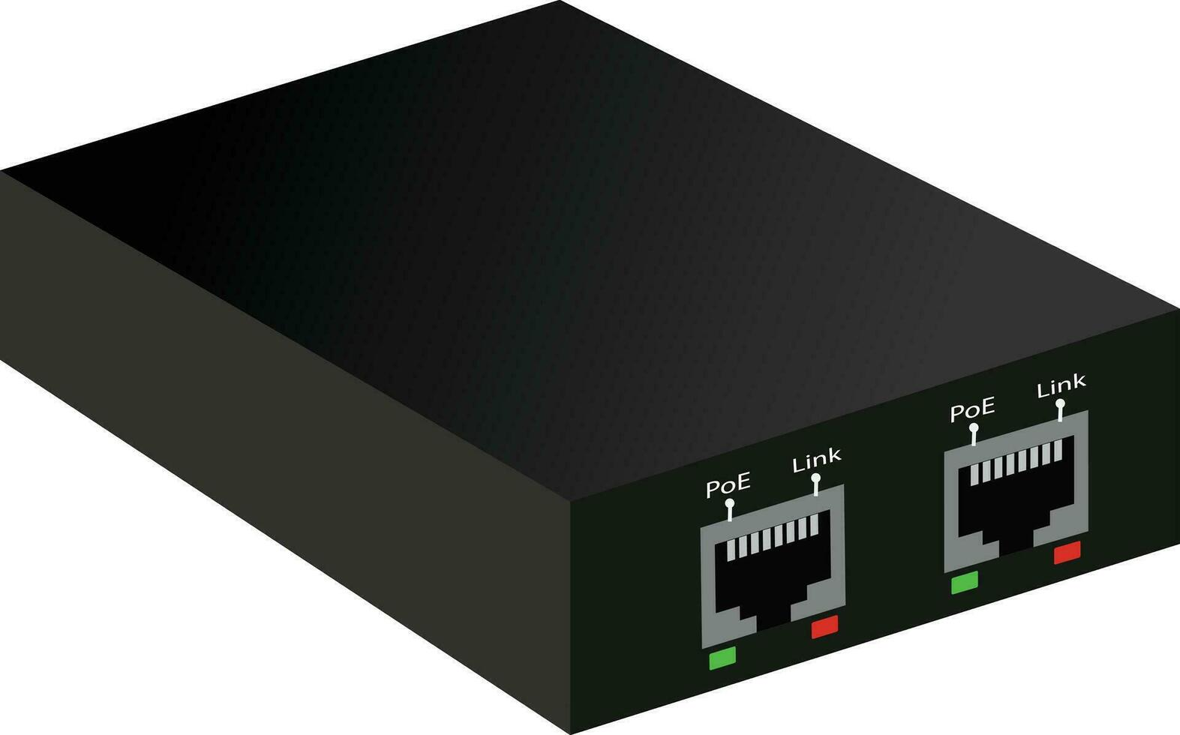
Bridges
A bridge is a repeater, with add on the functionality of filtering content by reading the MAC addresses of the source and destination.
It is also used for interconnecting two LANs working on the same protocol.
It has a single input and single output port, thus making it a 2 port device.

Slide 11
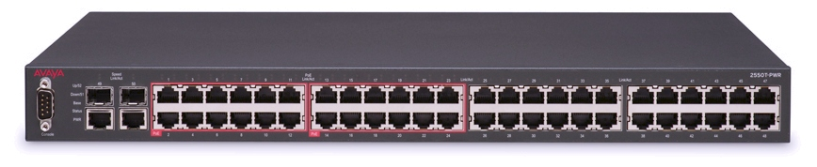
Switches
Multiport network bridge that uses MAC address to forward data.
In a local area network using Ethernet, a network switch determines where to send each incoming message frame by looking at the media access control (MAC) address.
Switches maintain tables that match each MAC address to the port receiving the MAC address.

Slide 12
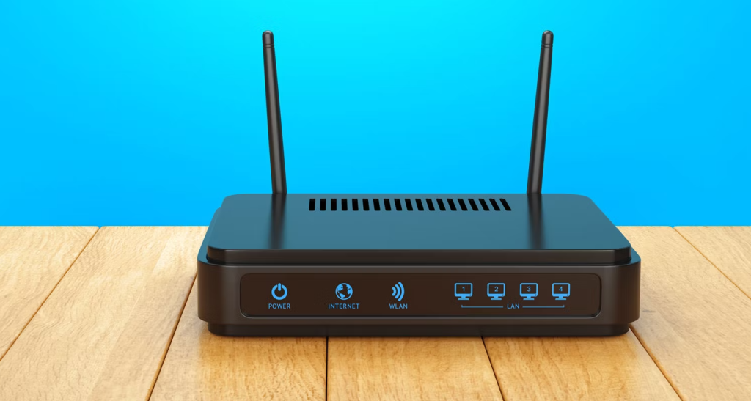
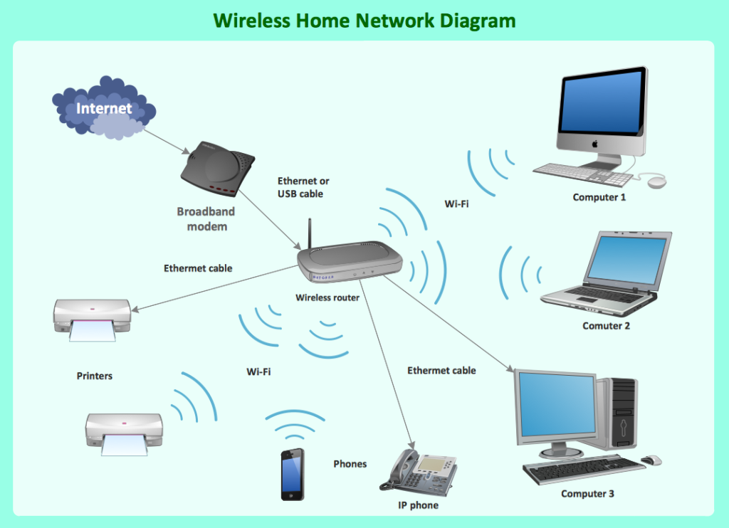
Routers
A router receives and sends data on computer networks.
Routers are sometimes confused with network hubs, modems, or network switches.
However, routers can combine the functions of these components, and connect with these devices, to improve Internet access or help create business networks.
It manages traffic between different networks and permits several devices to share an Internet connection.

Slide 13
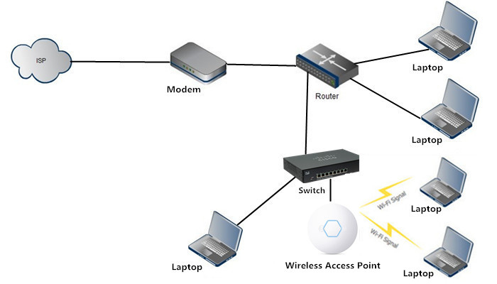
Wireless Access Point
Sub-device within the local area network that provides another location for devices to connect from and enables more devices to be on the network.

Slide 14
IP Address

Slide 15
IP Address
An Internet Protocol address (IP address) is a numerical label such as 192.0.2.1 that is assigned to a device connected to a computer network that uses the Internet Protocol for communication.
IP addresses serve two main functions: network interface identification, and location addressing.
MAC address: 48-bit
IP address: Two versions IPv4 and IPv6

Slide 16
Formats of IP Address
Internet Protocol version 4 (IPv4) defines an IP address as a 32-bit number.
Total addresses: 4,294,967,296
However, because of the growth of the Internet and the depletion of available IPv4 addresses, a new version of IP (IPv6), using 128 bits for the IP address, was standardized in 1998.
IPv6 deployment has been ongoing since the mid-2000s.
Theoretically allowing 2¹²⁸, or approximately 3.4×10³⁸ total addresses.

Slide 17
Distribution Authorities
The IP address space is managed globally by the Internet Assigned Numbers Authority (IANA), and by five regional Internet registries (RIRs) responsible in their designated territories for assignment to local Internet registries, such as Internet service providers (ISPs), and other end users.

Slide 18
Network ID & Host ID
An IP address is divided into two parts:
Network ID: Identifies the network to which the device belongs. It is used by routers to route packets to the correct network.
Host ID: Identifies the specific device within that network.
For example, in an IPv4 address 192.168.1.10 with a subnet mask 255.255.255.0:
Network ID: 192.168.1.0
Host ID: 10

Slide 19
Classes of IP Addresses
IPv4 addresses are classified into five classes (A, B, C, D, and E), each with a different range of IP addresses and use cases:
Class A:
Range: 0.0.0.0 to 127.255.255.255
Default Subnet Mask: 255.0.0.0
Network ID is the first octet, and the remaining three octets are for Host IDs.
Used for large networks.

Slide 20
Class B:
Range: 128.0.0.0 to 191.255.255.255
Default Subnet Mask: 255.255.0.0
Network ID is the first two octets, and the remaining two octets are for Host IDs.
Used for medium-sized networks.
Class C:
Range: 192.0.0.0 to 223.255.255.255
Default Subnet Mask: 255.255.255.0
Network ID is the first three octets, and the remaining octet is for Host IDs.
Commonly used for small networks.

Slide 21
Class D (Multicast):
Range: 224.0.0.0 to 239.255.255.255
Used for multicast groups, not for typical IP addressing.
Class E (Reserved):
Range: 240.0.0.0 to 255.255.255.255
Reserved for experimental purposes and not used for general network traffic.

Slide 22
IP Address Assignment in Windows
There are two main methods for assigning an IP address in Windows:
Automatically (DHCP - Dynamic Host Configuration Protocol):
DHCP automatically assigns IP addresses to devices on a network.
Steps:
Go to Control Panel → Network and Sharing Center.
Click on Change adapter settings.
Right-click on the network adapter and select Properties.
Select Internet Protocol Version 4 (TCP/IPv4) and click Properties.
Choose Obtain an IP address automatically and Obtain DNS server address automatically.

Slide 23
Manually (Static IP):
Users manually set a fixed IP address for a device.
Steps:
Follow steps 1-4 as above.
Select Use the following IP address.
Enter the IP address, Subnet mask, Default gateway, and DNS server.
Click OK to apply the settings.

Slide 24
Ping Tool for Testing Connectivity
Use the ping command to verify connectivity between devices.
Open a command prompt or terminal on a connected device and type ping [IP address] (e.g., ping 192.168.1.1).
A successful ping shows that the devices can communicate over the network.

Slide 25
Building a small network
Move to Packet Tracer

Slide 26
Thank You.
The End

